Slide 1
Approaches for detecting AMR sequences within metagenomic data
(AKA “Where are the AMR genes within all of this other stuff”)
IMPORTANT NOTE: This lecture applies to all types of genes!!

Slide 2
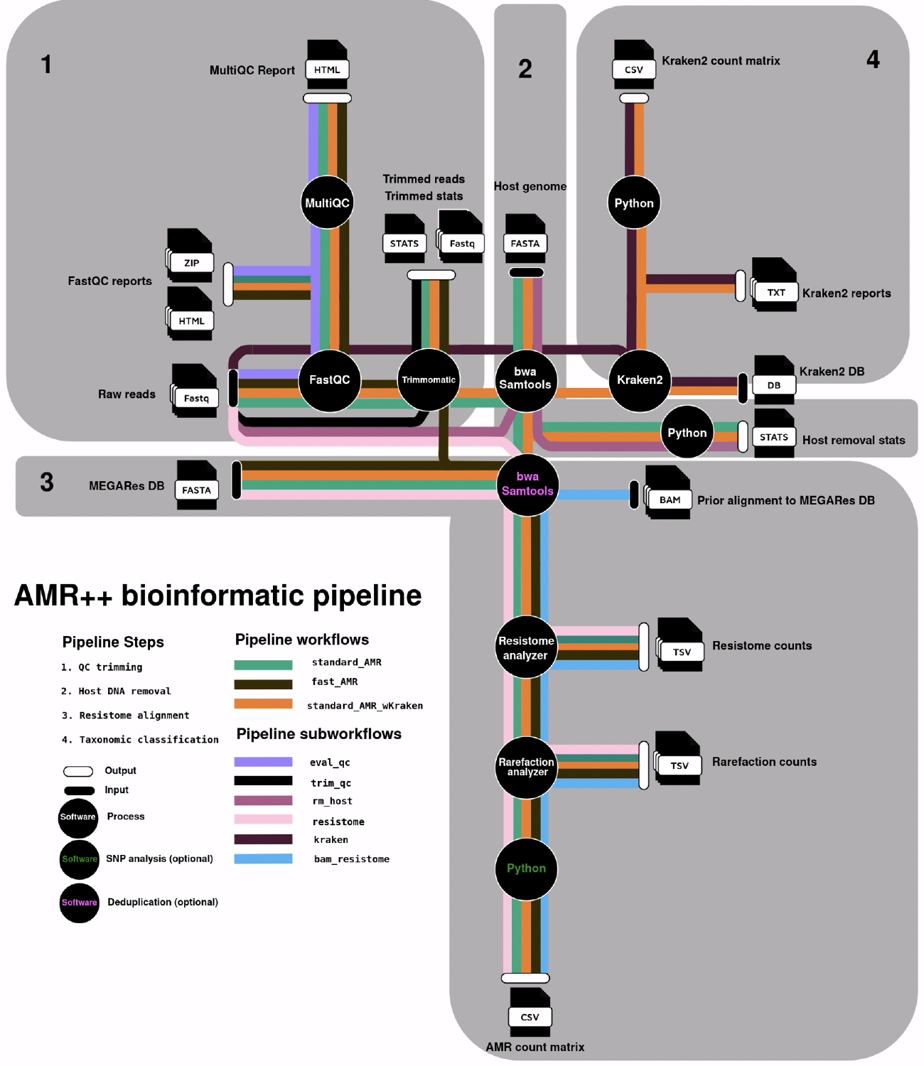
Notes:
- So how do we actually correct for Illumina systemic bias?
- We do this with read trimming, which is done as the first step in the AMR++ pipeline.

Slide 3
What is our goal?
To describe and/or compare resistomes in a set of samples!!
To do that, we must identify and quantify AMR genes
To do that, we must find and count AMR genes in metagenomic data

Slide 4
Remember, that for all of the options we will cover today, it all comes down to matching…
(And that’s why the databases are so important!)

Slide 5
Today, we will cover 2 options:
Assembly
Alignment

Slide 6
Today, we will cover 2 options:
Assembly
Alignment

Slide 7
Assembly involves “assembling” the short-read data into longer stretches of DNA called “contigs”, using k-mers
Image source: http://www.homolog.us/Tutorials/index.php?p=2.1&s=1

Slide 8
This quickly gets messy…

Slide 9
Benefit of assembly:
It can enable reconstruction of entire genomes – but not generally for metagenomic data
It can provide “genomic context” – but this is tricky for metagenomic data

Slide 10
Disadvantages of assembly (for metagenomic data):
Requires large amounts of RAM
Does not utilize all of the sequence data
Prone to assembly errors (especially for ARGs)
Produces sub-par assemblies (especially for ARGs)
“Collapses” sequence variability

Slide 11
Let’s look briefly at a paper comparing assemblers for metagenomic samples…Specifically, Table S2.
http://journals.plos.org/plosone/article?id=10.1371/journal.pone.0169662

Slide 12
Disadvantages of assembly (for metagenomic data):
Utilizes lots of computational resources
Does not utilize all of the sequence data
Prone to errors
Produces sub-par assemblies
“Collapses” sequence variability

Slide 13
Disadvantages of assembly (for metagenomic data):
ATGGACAG Read 1
ATGGACAG Read 2
ATGGACAG Read 3
ATGGACAG Read 4
ATGGACAG Read 5
ATTGACAG Read 6

Slide 14
Once you have the assembly, you then use BLAST (or something similar) to compare contigs to reference database (e.g., MEGARes)

Slide 15
Today, we will cover 2 options:
Assembly
Alignment

Slide 16
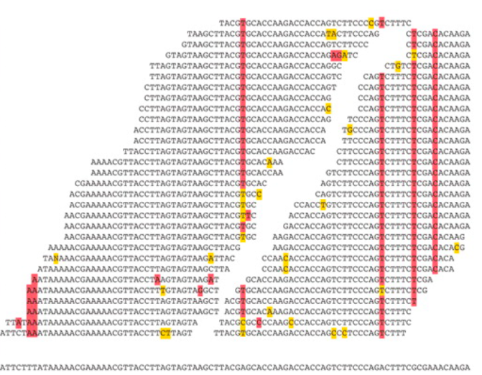
Basic Alignment Approach
Sample Sequence
(reads!)
Figure courtesy of Dr. Ken Jones
Reference Sequence

Slide 17
Important characteristics:
The match does not have to be perfect
Matching is performed at the unit of the read
The alignment preserves a lot of information

Slide 18
Benefits of alignment:
Utilizes all of the (relevant) sequence data
Relatively quick (computationally)
Preserves sequence variability
Preserves the original sequence (no “assembly error”)

Slide 19
Disadvantages of alignment:
Does not provide genomic context
Can be prone to false-positive identification of, e.g., AMR genes
Must make arbitrary decisions when there are homologous stretches of DNA between reference sequences

Slide 20
Disadvantages of alignment:
Does not provide genomic context
Can be prone to false-positive identification of, e.g., AMR genes
Must make arbitrary decisions when there are homologous stretches of DNA between reference sequences

Slide 21
Is it really an AMR gene?
Non-AMR gene
AMR gene
In the real world

Slide 22
Is it really an AMR gene?
Non-AMR gene
AMR gene
In the real world
Only this one is in our reference database!

Slide 23
Is it really an AMR gene?
Non-AMR gene
AMR gene
Sample

Slide 24
Is it really an AMR gene?
Non-AMR gene
AMR gene
Sample
Data

Slide 25
Is it really an AMR gene?
Non-AMR gene
AMR gene
Sample
Data
AMR gene reference
Alignment

Slide 26
So what do we do about this?
We use a “gene fraction” cutoff
(sometimes called gene “coverage”: AVOID THIS TERM)
Gene Fraction: The % of nucleotides in a given reference sequence that have at least one mapped (aligned) read

Slide 27
Some examples:
AMR gene reference
Alignment Pile-up
(reads)

Slide 28
Some examples:
AMR gene reference
Alignment Pile-up

Slide 29
Some examples:
AMR gene reference
Alignment Pile-up

Slide 30
Some examples:
AMR gene reference
Alignment Pile-up

Slide 31
Some examples:
AMR gene reference
Alignment Pile-up

Slide 32
Disadvantages of alignment:
Does not provide genomic context
Can be prone to false-positive identification of, e.g., AMR genes. Solution: Gene Fraction Cutoff (ResistomeAnalyzer)
Must make arbitrary decisions when there are homologous stretches of DNA between reference sequences

Slide 33
Notes:
- So how do we actually correct for Illumina systemic bias?
- We do this with read trimming, which is done as the first step in the AMR++ pipeline.

Slide 34
Disadvantages of alignment:
Does not provide genomic context
Can be prone to false-positive identification of, e.g., AMR genes. Solution: Gene Fraction Cutoff (ResistomeAnalyzer)
Must make arbitrary assignments when there are homologous stretches of DNA between reference sequences

Slide 35
Is it really an AMR gene?
AMR gene 1
AMR gene 2
Reference

Slide 36
Is it really an AMR gene?
AMR gene 1
AMR gene 2
Reference
Sample

Slide 37
Is it really an AMR gene?
AMR gene 1
AMR gene 2
Reference
Sample
Data

Slide 38
Is it really an AMR gene?
AMR gene 1
AMR gene 2
Reference
Sample
Data
AMR gene 1
AMR gene 2
?
Alignment

Slide 39
NOTE that this same phenomenon happens for taxonomic assignments (more on this later)

Slide 40
What can we do?
Default of the aligner = random assignment
You can also force aligner to output all possible alignments (but this means you will “double count”)
You can ”sidestep” the issue by conducting your analyses at a “higher level” – more on this later!

